Slide 1
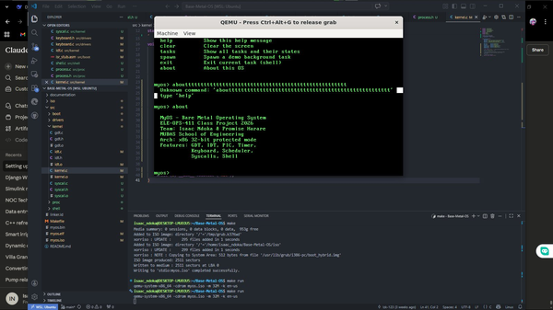
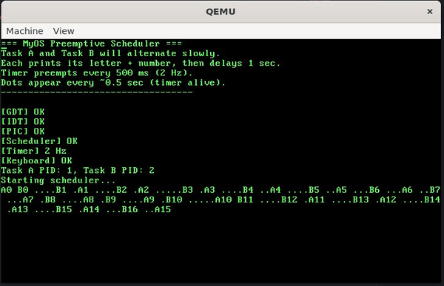
MyOS
Bare-Metal Operating System Kernel
for x86 Architecture
Isaac Ndoka & Promise Harare
ELE-OPS-411 | MUBAS | 2026
ELE-OPS-411 Class Project | April 2026

Slide 2
Project Overview
~2,400
16
256
6
Lines of Code
Source Files
Interrupts
Shell Commands
C + Assembly
across 5 subsystems
IDT entries handled
built-in commands
What is MyOS?
Tools Used
Bare-metal kernel written in C + x86 Assembly
Boots via GRUB using the Multiboot specification
Runs on QEMU virtual hardware (x86 32-bit protected mode)
No standard library — all utilities written from scratch
Built by 2 beginners, from zero to working OS
GCC -m32 Compiler
NASM Assembler
GNU ld Linker
QEMU Virtual HW
GRUB Bootloader
Git/GitHub Version Ctrl

Slide 3
System Architecture
Shell
Design Principles
shell.c — 6 built-in commands, keyboard read-line
▼
No libc
System Calls
syscall.c — int 0x80 (write, spawn, exit)
Everything from scratch
▼
Scheduler + PCB
process.c, switch.asm — round-robin, do_switch()
Flat model
▼
Base=0, Limit=4GB GDT
Interrupt System
idt.c, isr_stub.asm, pic.c, timer.c, keyboard.c
int 0x80
▼
Linux-style syscall ABI
GDT + Memory
gdt.c — flat 32-bit protected mode, 3 descriptors
▼
BLOCKED state
Boot + VGA
True blocking keyboard I/O
boot.asm (Multiboot), vga.c (0xB8000 framebuffer)

Slide 4
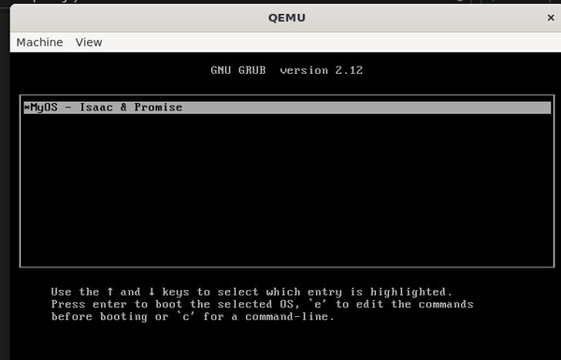
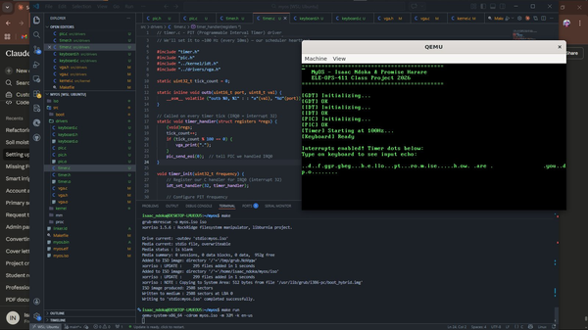
Phase 1 & 2 — Boot, Console & Interrupts
PHASE 1
Boot & VGA Console
Multiboot header — GRUB magic 0x1BADB002
Kernel loads at 0x100000 (1 MB physical)
VGA framebuffer at 0xB8000 — 80×25 chars
Custom linker.ld + freestanding Makefile
Figure 1: GRUB boot menu detecting MyOS
PHASE 2
Interrupts — GDT, IDT, PIC
GDT: 3 descriptors — null, code, data
IDT: 256 gates — exceptions + IRQ handlers
PIC remapped: IRQs 0-15 → vectors 32-47
Timer 100 Hz + PS/2 keyboard (ring buffer)
Figure 2: Phase 2 — timer dots + keyboard echo confirmed

Slide 5
Phase 3 — Preemptive Round-Robin Scheduler
Context Switch — do_switch()
push ebp, ebx, esi, edi ; save callee regs
mov [old_esp], esp ; save current ESP
mov esp, new_esp ; load new stack
pop edi, esi, ebx, ebp ; restore new regs
ret ; jump to new task
Process Control Block (PCB)
pid uint32_t Process ID
state enum UNUSED/READY/RUNNING/BLOCKED/DEAD
esp uint32_t Saved stack pointer
stack uint8_t[] Private 8 KB kernel stack
entry fn ptr Task entry function
Figure 3: Task A and Task B alternating — genuine preemptive multitasking
1
2
3
4
5
Critical fix: Send EOI BEFORE calling schedule() — PIC must be re-armed before context switch
Timer IRQ fires
Send EOI to PIC
Mark task READY
Find next READY
do_switch()
→
→
→
→

Slide 6
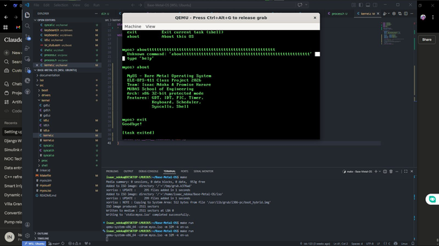
Phase 4 — System Calls & Interactive Shell
SYS_WRITE
SYS_SPAWN
SYS_EXIT
EAX=1
EAX=2
EAX=3
EBX = char*
Print string to VGA
EBX = fn ptr, ECX = name
Create new kernel task
Terminate current task
Mark PCB as DEAD
How it works:
mov eax, 1 | mov ebx, msg | int 0x80
Figure 4: 'help' command output + working shell prompt
IDT[0x80] → isr128 stub → isr_common → syscall_handler(regs) → dispatch on EAX
Shell Built-in Commands
help List all commands
clear Clear VGA screen
tasks Show PCB table
spawn SYS_SPAWN a task
about OS info
exit SYS_EXIT shell
Figure 5: 'about' + 'exit' via SYS_EXIT syscall

Slide 7
Key Challenges & Solutions
⚠ Curly quotes broke linker.ld
⚠ Scheduler fired only once!
✓ Recreated file with terminal heredoc (cat << EOF)
✓ Moved EOI BEFORE schedule() — critical fix!
⚠ GCC generated GOT references
⚠ Context switch — tasks exiting immediately
✓ Added -fno-pic -fno-pie flags to CFLAGS
✓ mem_set only the stack, not the whole PCB struct
⚠ GRUB: invalid ELF magic error
⚠ Keyboard not responding in QEMU
✓ Removed --oformat binary; output proper ELF
✓ Added -k en-us flag; click QEMU window for focus
⚠ IRQ stubs undefined reference
⚠ Keyboard CPU busy-wait
✓ Fixed macro: used %1 suffix → irq0-irq15
✓ Implemented TASK_BLOCKED wait queue

Slide 8
What We Built — Feature Summary
Phase 1
Phase 2
Phase 3
Phase 4
Extras ★
Multiboot + GRUB boot
GDT — flat 32-bit mode
PCB + task_create()
int 0x80 syscall ABI
Shell as kernel task
VGA text driver 80×25
IDT — 256 gate descriptors
do_switch() in ASM
SYS_WRITE/SPAWN/EXIT
Dead slot reclamation
Custom linker script
8259A PIC remapping
Preemptive round-robin
Interactive shell
Blocking wait queue
GNU Makefile build
100 Hz timer + keyboard
2-task alternation ✓
6 built-in commands
TASK_BLOCKED state
All minimum required features complete ✓

Slide 9
Live Demo
Boot
Repository
1
make run → GRUB menu → kernel banner
Platform:
GitHub
Repo:
Base-Metal-OS
Interrupts
2
Branch:
main
Timer ticks + type on keyboard = echo
Build:
make
Run:
make run
Scheduler
3
Debug:
make debug
Two tasks A & B alternating on screen
Deliverables
Shell
4
Git repo + README.md
Type 'help' 'tasks' 'about' 'spawn' 'exit'
Written report (APA 7)
This presentation
Terminal:
make clean && make && make run
Demo video (5-8 min)

Slide 10
Thank You
We Built:
✓
Boot + VGA
Phase 1
✓
GDT/IDT/PIC/IRQ
Questions & Discussion
Phase 2
✓
Scheduler
Isaac Ndoka & Promise Harare
Phase 3
✓
Syscalls + Shell
ELE-OPS-411: Operating Systems for Engineers
Phase 4
MUBAS — School of Engineering | April 2026
✓
Blocking I/O ★
Extra
✓
Dead slot GC ★
Extra
"Built from scratch — one interrupt at a time"

